Slide 1
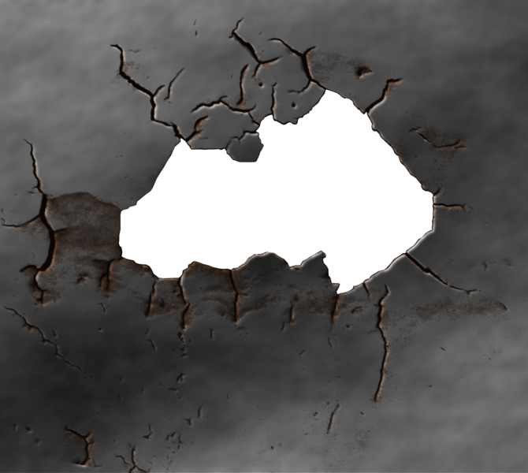
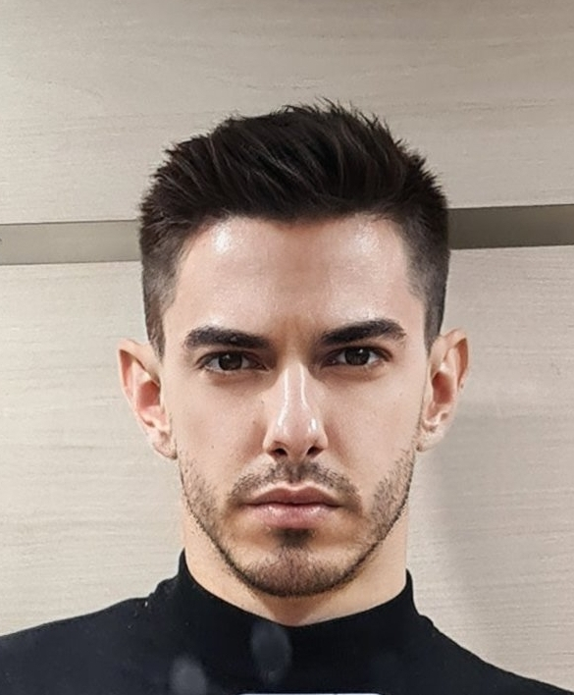




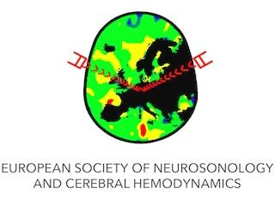
TCD in Right to Left Shunt Diagnosis
25th ESNCH Conference in Belgrade, Serbia from October 15-17, 2021
Dmitar Vlahović, MD
Neurointensive Care Unit, Neurology Clinic, Clinical Center of Vojvodina
Faculty of Medicine, University of Novi Sad, Serbia
The story about a hole in the wall…

Slide 2
Learning objectives
Embryology of Right-to-Left Shunt (RLS)
Significance of RLS
Importance and handiness of TCD in making diagnosis
How to perform examination
Potential role of RLS in stroke etiology
Management of RLS
Other conditions associated with RLS

Slide 3
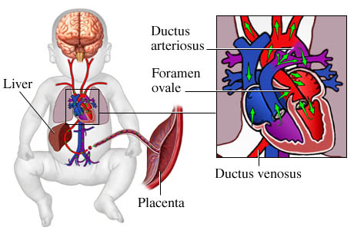
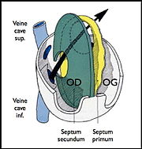
First… Embryology!
Foramen ovale is a physiological opening during fetal development
Opening between septum primum and septum secundum, located on inter-atrial wall of the heart
Function: bypassing lung circulation
Closing of foramen ovale during first few weeks after birth until 2nd year of life

Slide 4
PFO
Patent/persistant foramen ovale (PFO)
Incomplete closure of inter-atrial septum
20-30% adult population have PFO
In most cases, PFO is incidentally detected, or remains undetected
PFO can be associated with atrial septal aneurysm (ASA), Chiari network, Eustachian valve
Calvert PA. Nat Rev Cardiol 2011;8:148–60.

Slide 5
PFO
Contrast TTE
Contrast TEE
≈ 17% of healthy adult population older than 39. years have PFO
2.5% have ASA
≈ 24% of healthy adult population older than 45. years have PFO
4.3% have ASA
Homma S, Sacco RL, Circulation 2005

Slide 6
PFO
⇩ Prevalence with increasing age
  30% in young adults <30 years
  25% in 30-79 years
  20% in older than 80 years
SIZE of PFO is ⇧ with increasing age (dilatation of fossae ovalis)
Hagen PT. Mayo Clin Proc 1984;59:17–20.

Slide 7
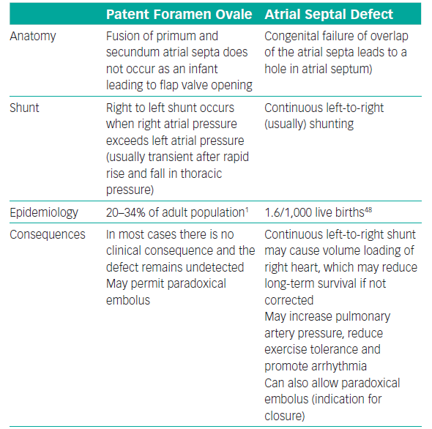
PFO
Despite their differences, both PFO and ASD can be a gateway for paradoxical embolization
P Giblett JP, et al. Patent Foramen Ovale Closure: State of the Art. Interv Cardiol. 2020;15:e15.

Slide 8
Diagnosis of PFO
c-TTE and/or c-TEE
Positive test
  At least 1 (according some authors 3) MES in left atrium during 3 cardiac cycles (some authors 5)
  At least 1 (according some authors 3) MES in left atrium 10 seconds after visual contact of contrast agent in right atrium
Sensitivity can be increased by:
  Valsalva maneuver
  Injecting contrast agent into femoral vein
  Cough

Slide 9
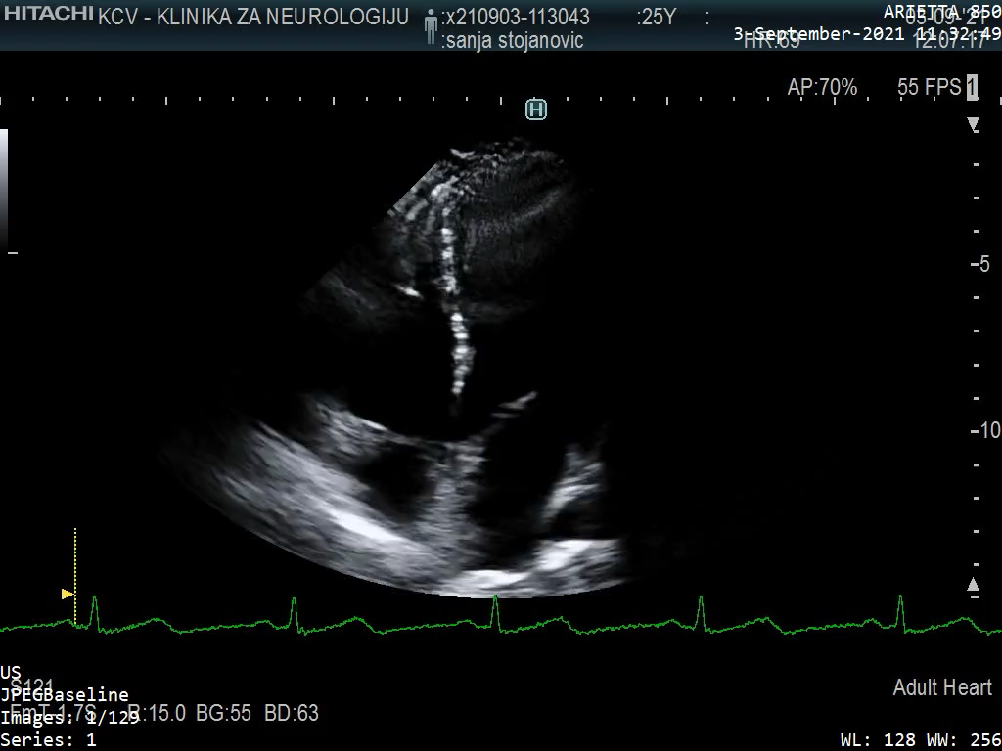
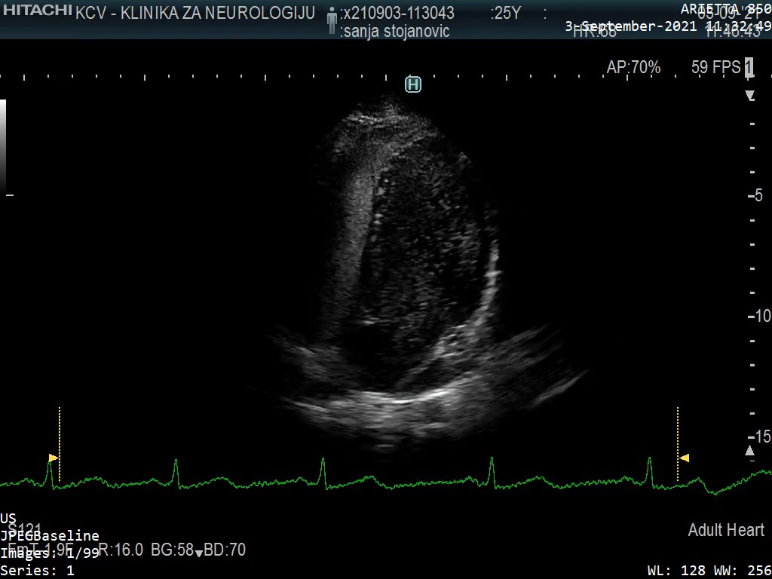
Diagnosis of PFO

Slide 10
”GOLD” standard for detecting PFO – contrast TEE
Advantages
Disadvantages
Superior than c-TTE for inter-atrial septum morphology
Can detect small thrombus (<1-2mm)
Sensitivity 89%, specificity 100%
Semi-invasive method
Requiring sedation (less cooperation for Valsalva maneuver)
Can be challenging in patients with stroke (cooperation, dysphagia)
Can not detect small shunts ⇨ False negative
Kim YJ, et al. Patent foramen ovale: diagnosis with multidetector CT-comparison with TEE. Radiology. 2009;250:61–67.

Slide 11
Place of TCD in diagnosis of R-L Shunt
TCD first handy tool of neurologist
TCD in M mode – ”blind” method
Color Coded TCD – ”see & listen”

Slide 12
Place of TCD in diagnosis of R-L Shunt
Screening tool
Best for detecting cardiac shunt
Based on detecting micro embolic signals (MES) after application of contrast agent
Detecting just 1 MES is sufficient for diagnosis of R-L Shunt

Slide 13
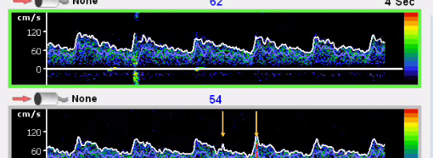
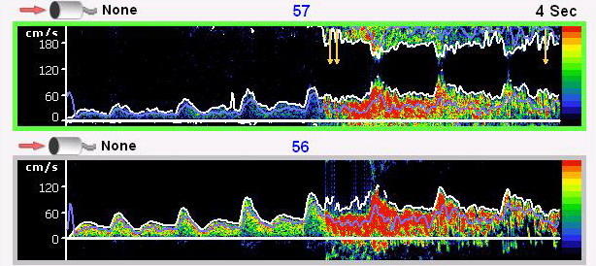
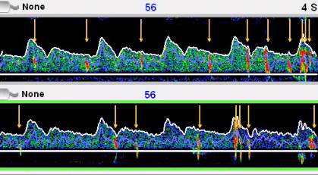
Shunt Quantification
Negative study 0 MES
Small R-L Shunt 1-10 MES
Large R-L Shunt >10 MES
Shower >25 MES
Curtain – single MES are not recognizable
1-10 MES gradus I
11-30 MES gradus II
31-100 MES gradus III
101-300 MES gradus IV
>300 MES gradus V

Slide 14
Doppler Characteristics of MES
Transient, usually lasting less than 300 ms
The amplitude is usually at least 3 dB higher than background blood flow signal
Is unidirectional within velocity spectrum
It's followed by a “snap” as audio output

Slide 15
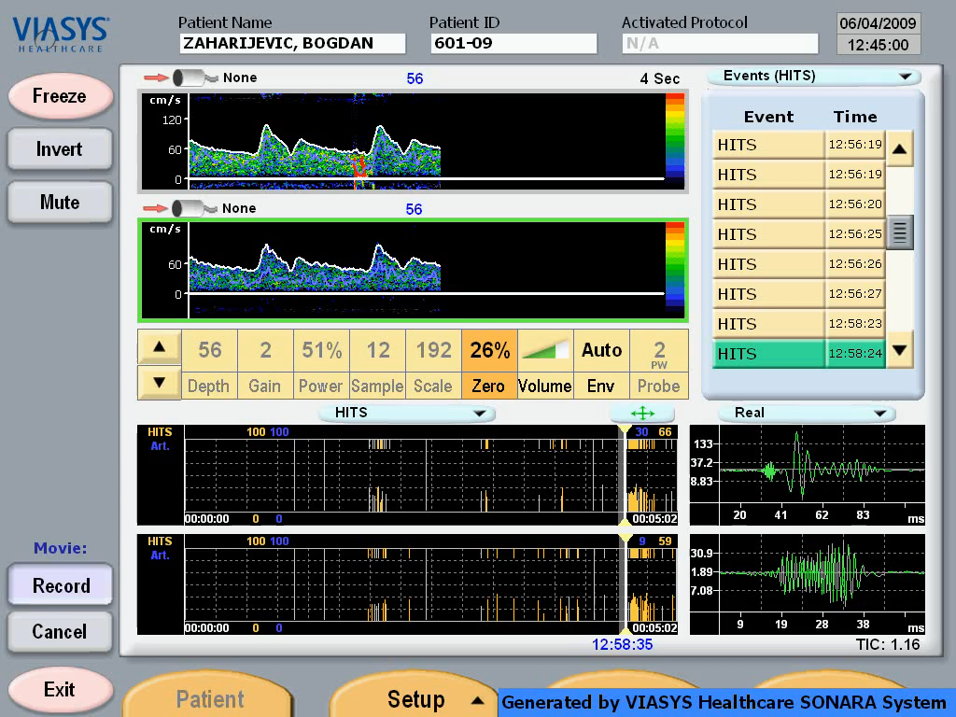

Slide 16
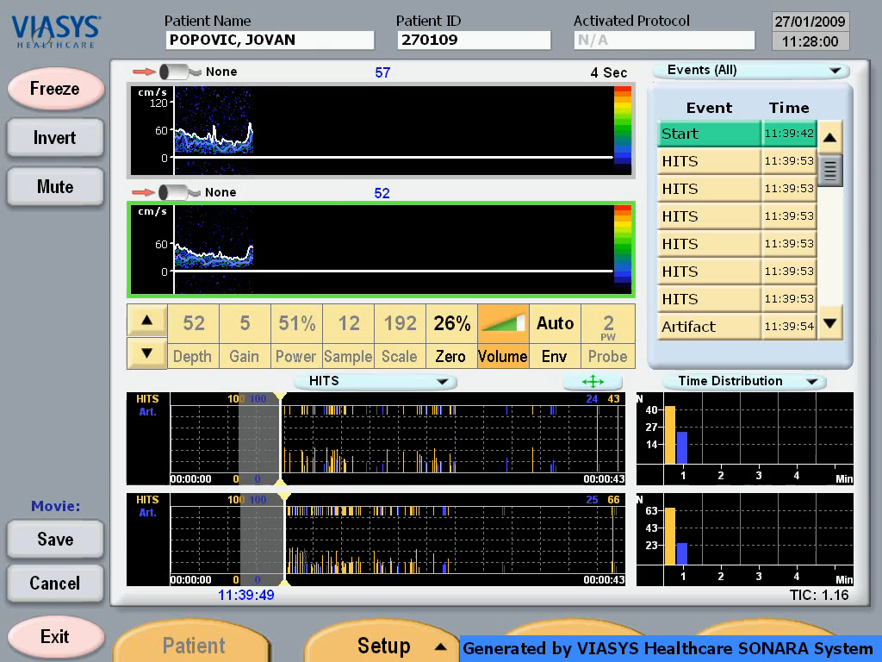

Slide 17
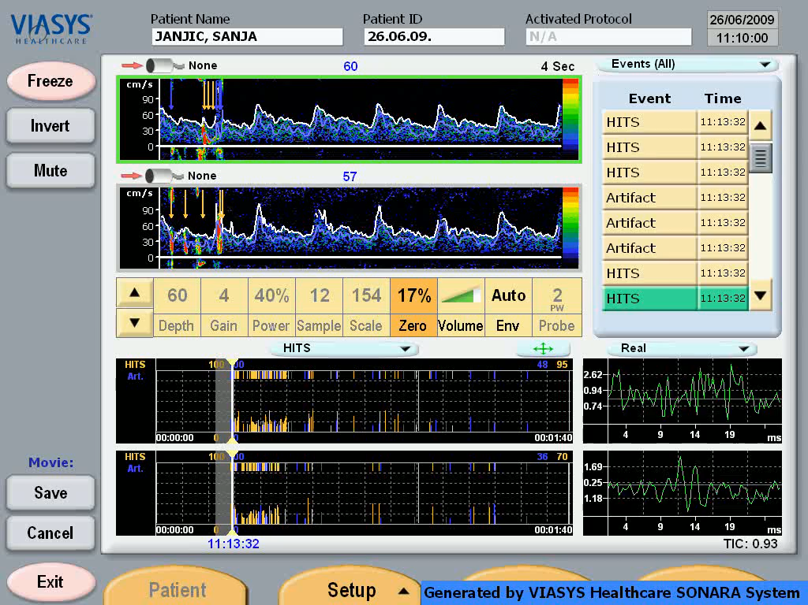

Slide 18
Advantages
Disadvantages
Non-invasive
Safe
Easily performed and cheap
Takes ≈15 minutes
Sensitivity 89%, specificity 92%
Doesn’t provide us information about:
  Morphology
  Size
Positive study, not always ≠ PFO
  94% PFO
  5% pulmonal AV fistulas
  1% ASD
Unavailable acoustic bone window in 10%!
Tsivgoulis G, et al. Safety of transcranial Doppler ‘bubble study’ for identification of right to left shunts: an international
multicentre study. J Neurol Neurosurg Psychiatry 2011; 82:1206-1208.

Slide 19
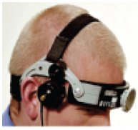
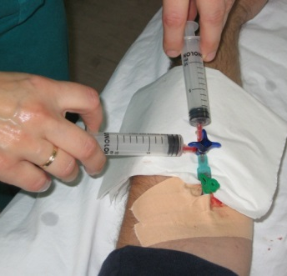
Procedure…
18G needle inserted in antecubital vein
Patient lying in supine position
MCA is insonated
The contrast agent is injected as a bolus during normal respiration and repeated after Valsalva maneuver
Contrast agent – agitated saline (mixed 1ml of air and 9ml of saline)

Slide 20
How test can be improved?
Using 10ml of saline
25-40 second time window for excluding other sources
Bilateral monitoring
Performing Valsalva maneuver for 5 second 5-10 seconds after contrast bolus
Preforming procedure 2x

Slide 21
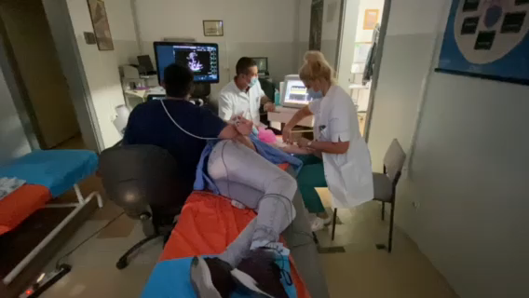

Slide 22
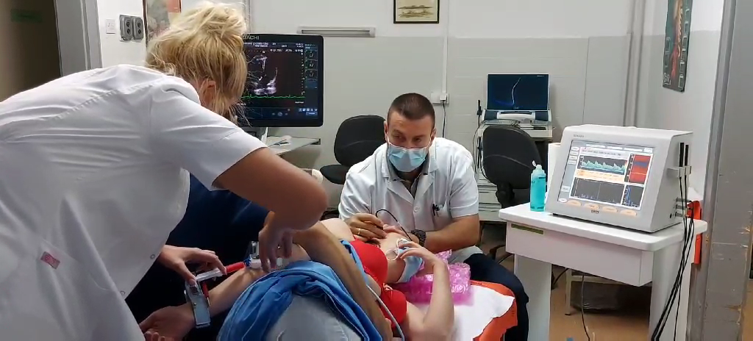

Slide 23
What is the relevance?
Blood clots, air or some vasoactive substances can in certain situation pass trough the PFO and enter systemic circulation
This is called paradoxical embolization
Term first described by Cohnheim in 1877.
Can be associated with:
  Ischemic stroke
  Systemic embolization
  Decompressive disease of divers
  Migraine with aura

Slide 24
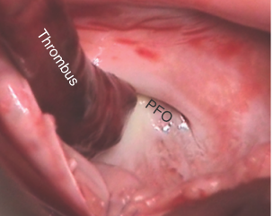
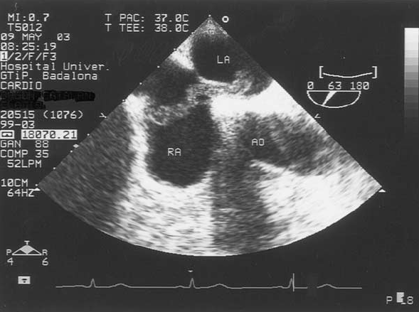
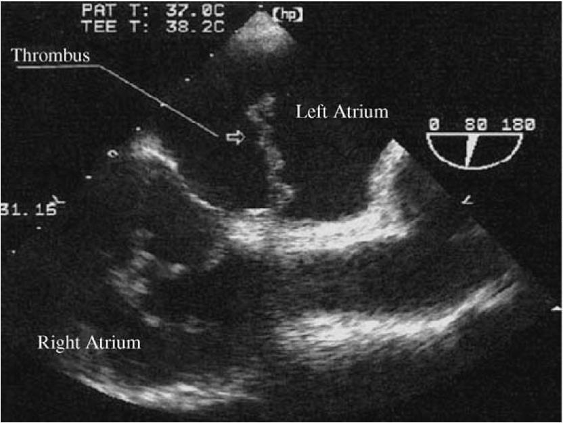
Paradoxical Embolization

Slide 25
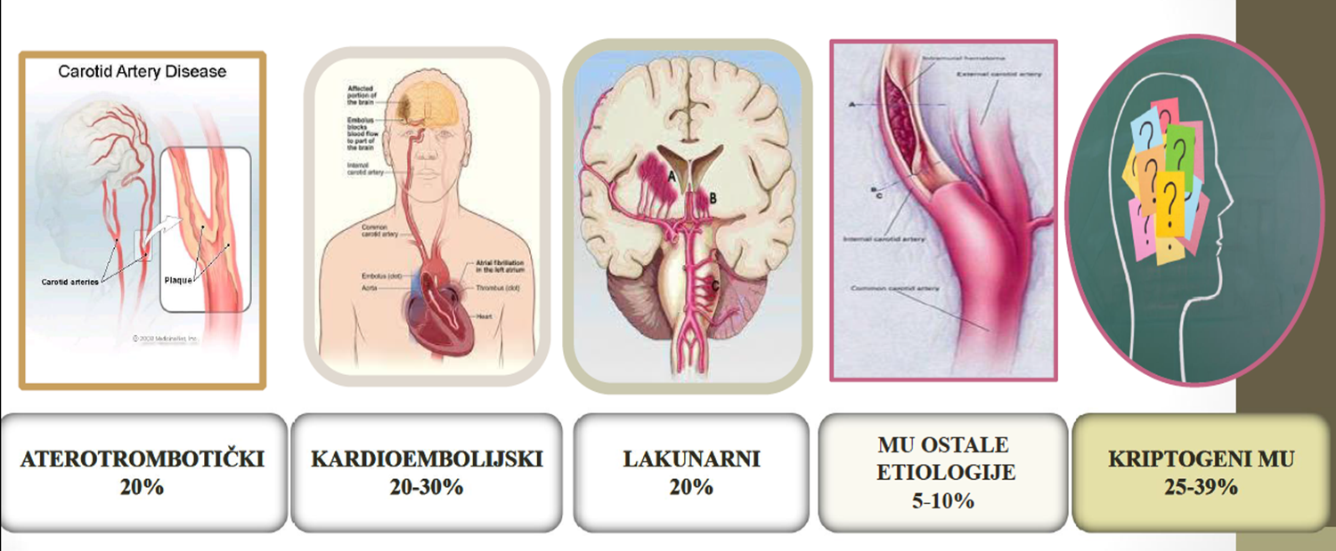
Cryptogenic stroke
LAA
20%
Cardioembolization 20-30%
SVD
20%
Other determined
Undetermined / cryptogenic
25-39%
Adams HPJ, et al. Classification of subtype of acute ischemic stroke. Definitions for use in a multicenter clinical trial. TOAST. Trial of Org 10172 in Acute Stroke Treatment. Stroke 1993;24:35–41.

Slide 26
Stroke and PFO
Potential mechanism of action
Increased risk of stroke recurrence
Paradoxical embolization
  Due to ⇧ pressure in the right heart
  Source of emboli (DVT…)
In situ thrombosis in the PFO canal (minor shunt)
Increased pressure in the right heart
Hypercoagulable state
Large PFO
P Giblett JP, et al. Patent Foramen Ovale Closure: State of the Art. Interv Cardiol. 2020;15:e15.

Slide 27
How can stroke look like with PFO?
More often stroke in posterior circulation
Many smaller cortical infarcts – associated with larger PFO
“Silent”infarcts
Kim BJ, et al. Imaging characteristics of ischemic strokes related to patent foramen ovale. Stroke. 2013;44:3350–3356.

Slide 28
Drug treatment of stroke patients with PFO
Kent DM, et al. An index to identify stroke-related vs incidental patent foramen ovale in cryptogenic stroke. Neurology. 2013;81:619–625.
Kent DM, et al. Risk of Paradoxical Embolism (RoPE)-Estimated Attributable Fraction Correlates With the Benefit of PFO Closure: An Analysis of 3 Trials. 2020;51(10):3119-3123.

Slide 29
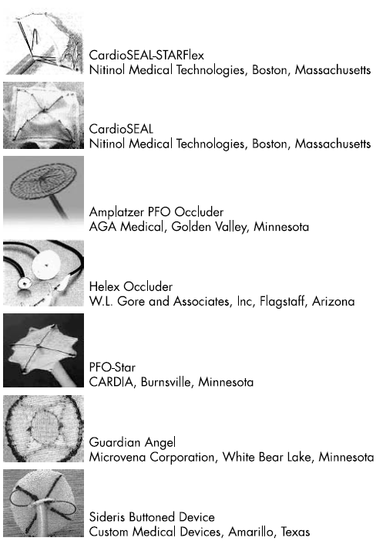
Percutaneous closure of PFO
First performed in 1992.
Bridges ND, Hellenbrand W, Latson L, Filiano J, Newburger JW,Lock JE. Transcatheter closure of patent foramen ovale after presumed paradoxical embolism. Circulation 1992;86:1902– 8.

Slide 30
Percutaneous closure of PFO
Procedure does not bring immediate symptomatic benefit
Complications can happen!
  Femoral venous approach, ECHO guidance, adequate anticoagulation
Periprocedural management with TEE is mandatory, recommended by the Society for Cardiovascular Angiography and Intervention 2019
Bechis MZ, et al. Imaging assessment of the interatrial septum for transcatheter atrial septal defect and patent foramen ovale closure. Interv Cardiol Clin 2017;6:505–24.
Horlick E, et al. SCAI expert consensus statement on operator and institutional requirements for PFO closure for secondary prevention. Catheter Cardiovasc Interv 2019;93:859–74.

Slide 31
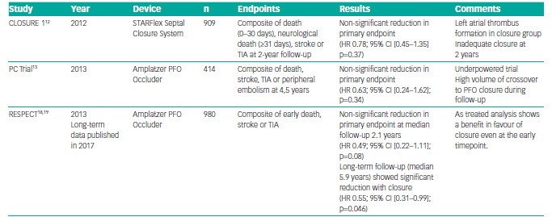
RCTs Comparing PFO Closure with Medical Therapy
Sondergaard L, et al. Patent foramen ovale closure or antiplatelet therapy for cryptogenic stroke. N Engl J Med 2017;377:1033–42.
Lee PH, et al. Cryptogenic stroke and high-risk patent foramen ovale: the DEFENSE-PFO trial. J Am Coll Cardiol 2018;71:2335–42.
Mas JL, et al. Patent foramen ovale closure or anticoagulation vs. antiplatelets after stroke. N Engl J Med 2017;377:1011–21.

Slide 32
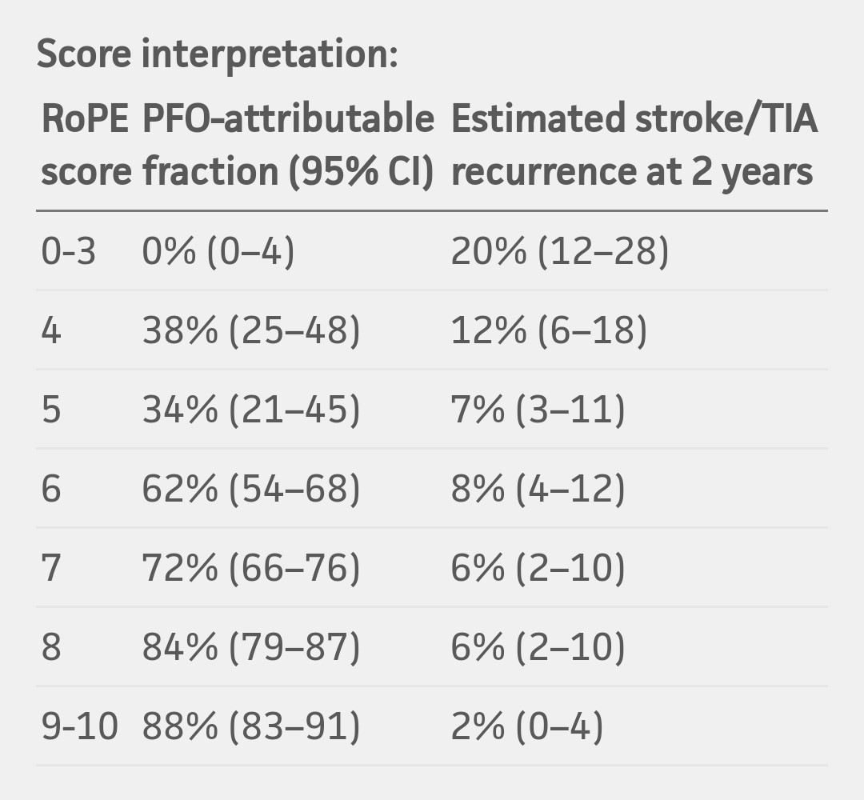
RoPE score
(The Risk of Paradoxical Embolism Study)
Mas JL, Derumeaux G, Guillon B, et al. N Engl J Med 2017;377:1011–1021.

Slide 33
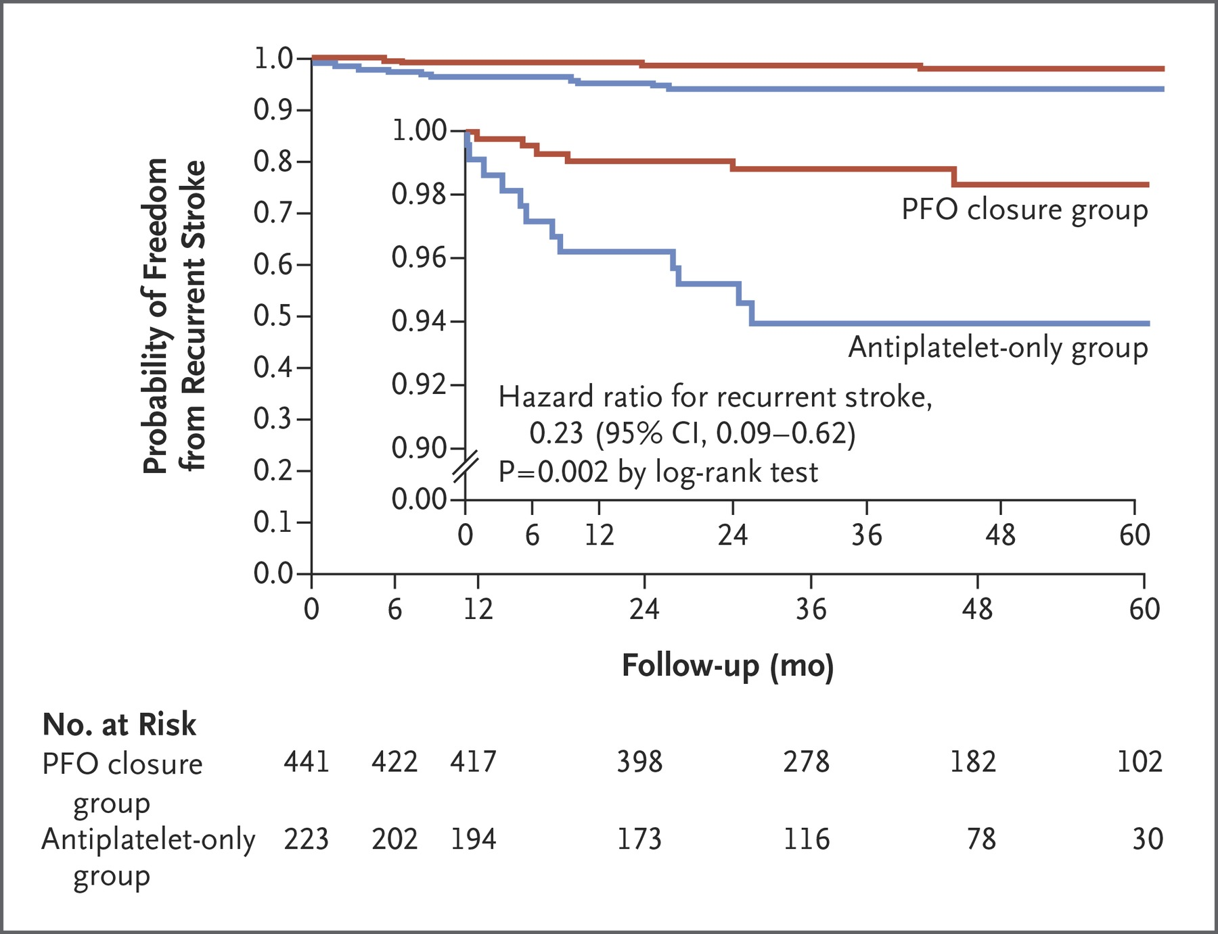
REDUCE (PFO closure or Antiplatelate Therapy for Cryptogenic Stroke)
18-59 y.o.
664 patients
With stroke and moderate large PFO
High RoPE score
2 groups
  PFO closure group + long term AP th (300mg Clopidogrel) – Helex septal or Cardioform occlude, 441 pts
  AP group alone (ASA, Clopidogrel, ASA + Dipyridamole) – 223 pts
Occurrence of new stroke was signif. lower in PFO group
SAE – without statis. signif. Differences between groups, as well as adverse events related to occlusion implantation
Sondergaard L, Kasner SE, Rhodes JF, et al. Patent foramen ovale closure or antiplatelet therapy for cryptogenic stroke. N Engl J Med 2017;377:1033–1042.

Slide 34
DEFENSE-PFO (Cryptogenic stroke and high-risk patent foramen ovale)
18-80 y.o., 120 patients
Large PFO or PFO + ASA
Two groups:
  PFO closure group (Amplatzer occluder) + long term AP th
  Medical therapy (AP or AC)
no recurrent strokes in those pts who underwent closure
AE - Periprocedural complications occurred in 3.3% and there was no reported periprocedural AF
Lee PH, Song JK, Kim JS, et al. Cryptogenic stroke and high-risk patent foramen ovale: the DEFENSE-PFO trial. J Am Coll Cardiol 2018;71:2335–2342.

Slide 35
Patent foramen ovale closure vs. medical therapy for cryptogenic stroke: a meta-analysis of RCTs
Closure of PFO results in a significant reduction
  absolute (0.6% per year; 3.4% for five years)
  relative (HR 0.41) risk of recurrent stroke in well-selected patients with cryptogenic stroke
Ahmad Y, et al. Patent foramen ovale closure vs. medical therapy for cryptogenic stroke: a meta-analysis of randomized controlled trials. Eur Heart J. 2018 May 7;39(18):1638-1649.
Abo-Salem E, et al. Patent foramen ovale closure versus medical therapy in cases with cryptogenic stroke, meta-analysis of randomized controlled trials. J Neurol 2018;265:578–85.

Slide 36
Safety of PFO closure
Favilla CG, Messe CR. Patent foramen ovale and stroke: current evidence and treatment options. Curr Opin Neurol. 2020 Feb;33(1):10-16.

Slide 37
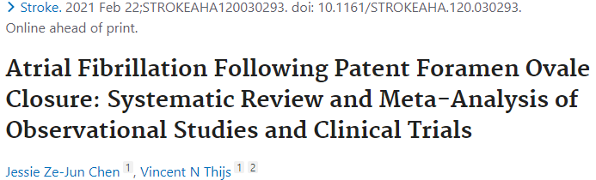
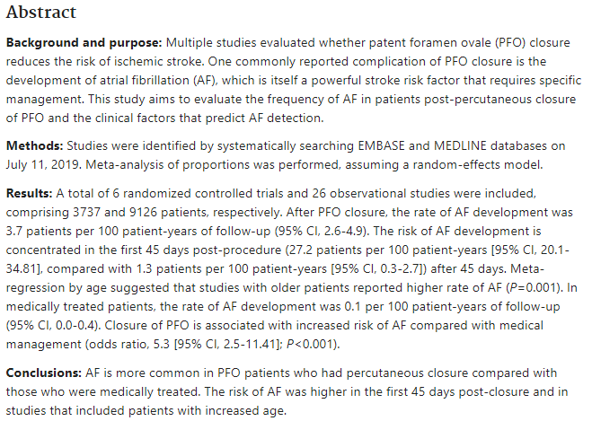

Slide 38
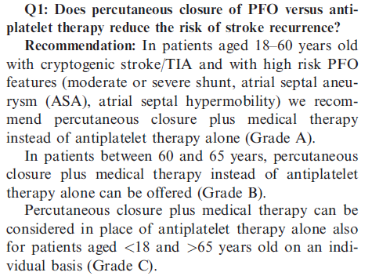

Slide 39
Migraine and PFO
Migraine with aura has about 1/3 of all migraine patients
Incidence of PFO in migraine patients is significantly higher than in general population
In the population with PFO, the incidence of migraine is also higher than in the general population
Among migraine patients with aura, the incidence of PFO is 46.3-88%; versus 16.2-34.9% in migraine without aura
In the case of PFO, some vasoactive matter could bypass the pulmonary circulation and pass directly through the brain
Finocchi C, Del Sette M. Migraine with aura and patent foramen ovale: myth or reality? Neurol Sci 2015;36:61–6.
Lip PZ, Lip GY. Patent foramen ovale and migraine attacks: a systematic review. Am J Med. (2014) 127:411–20.

Slide 40
PFO closure in migraine therapy - RCT
PRIMA & PREMIUM studies - assessing headache reduction in people with migraine after PFO closure
Both studies were negative for their primary outcomes, although there were some positive subanalysis
Evidence for PFO closure in migraine patients with aura is not strong enough for routine recommendation
Mattle HP, et al. Percutaneous closure of patent foramen ovale in migraine with aura, a randomized controlled trial. Eur Hear J 2016;37:2029–36.
Tobis JM, et al. Percutaneous closure of patent foramen ovale in patients with migraine: the PREMIUM trial. J Am Coll Cardiol 2017;70:2766–74.

Slide 41
Keep in mind…
TCD is convenient, cheap and reliable tool for detecting right-to-left shunts
It can not be used as single method
It is used as a screening tool
PFO is relatively common in healthy adults (25%) and should not be considered as an immediate cause of stroke
If you think about it, you will probably find it
In patients with PFO-related stroke (RoPE score ≥7) percutaneous closure results in significantly reduced the risk of recurrent stroke
PFO closure may be considered in some patients with systemic embolism and migraine with aura, but additional research is needed for clear recommendations

Slide 42


Thank you for your attention
E-mail: dmitar.vlahovic@mf.uns.ac.rs

